Slide 1
计算数学基础
沈复民
fumin.shen@gmail.com
电子科技大学 计算机科学与工程学院

Slide 2
课程简介
本课程是计算机科学与技术专业、信息安全专业的专业选修课程，主要论述矩阵分析中的经典方法与现代方法，是学生学习和掌握计算机科学与技术、信息安全以及通信、电子工程、自动控制等相关学科的理论知识的基础，同时，也是学生在相关的研究方向（例如：数字信号处理、数字图像处理、计算机视觉、模式识别、机器学习、数据挖掘、人工智能等）进一步学习和深造所需的基础理论知识。

Slide 3
课程目标
通过本课程学习，学生可以系统掌握矩阵分析的基本理论和方法，夯实数理基础。同时，本课程也为后续相关专业课程的学习以及进一步深造奠定基础。同时，本课程也旨在培养学生严谨的科学素养，提高学生推理、判断、分析问题的能力，提高学生的英文专业文献的阅读能力和水平。

Slide 4
教材
教材 | Matrix Analysis (Second Edition) | Roger A. Horn and Charles R. Johnson | Cambridge University Press 2013
参考书目 | Matrix Analysis 矩阵分析 卷1 （影印版） Topics in Matrix Analysis 矩阵分析 卷2 （影印版） Matrix Analysis (Second Edition) (中译版) | Roger A. Horn and Charles R. Johnson Roger A. Horn and Charles R. Johnson Roger A. Horn and Charles R. Johnson （张明尧，张凡译译） | 人民邮电出版社 2005年09月第1版 人民邮电出版社 2005年10月第1版 机械工业出版社 2014年09月 出版
授课时间 | 第 01 周——第 17 周

Slide 5
Matrix Analysis (Second Edition) (中译版), Roger A. Horn
and
Charles R. Johnson
（张明尧，张凡
机械工业出版社 2014年09月 出版
课程资料：http://pan.baidu.com/s/1i4FB8zF

Slide 6
考核方式
成绩构成及比例：期末成绩（70%）+平时成绩（30%）
如多次旷课将取消考试资格
课程资料：http://pan.baidu.com/s/1i4FB8zF

Slide 7
Chapter 0 Review and Miscellanea

Slide 8
Chapter 0 Review and Miscellanea
0.1 Vector Spaces

Slide 9
0.1 Vector Spaces
0.1.1 Scalar field
0.1.2 Vector spaces
0.1.3 Subspaces, span, and linear combinations
0.1.4 Linear dependence and linear independence
0.1.5 Basis
0.1.6 Extension to a basis
0.1.7 Dimension
0.1.8 Isomorphism

Slide 10
0.1 Vector spaces
A finite dimensional vector space is the fundamental setting for matrix Analysis.

Slide 11
0.1 Vector spaces
0.1.1 Scalar field
Underlying a vector space is its field, or set of scalars.
R or C
F

Slide 12
0.1 Vector spaces
0.1.1 Scalar field
To qualify as a field, a set must be closed under two binary operations: “addition” and “multiplication”.
Both operations must be associative and commutative;
Each must have an identity element in the set;
Inverses must exist in the set for all elements under addition and for
all elements except the additive identity under multiplication;
Multiplication must be distributive over addition.

Slide 13
0.1.2 Vector space
A vector space V over a field F is a set V of objects ( called vectors ) that is closed under a binary operation ( “addition” ) that is associative and commutative and has an identity ( the zero vector, denoted by “0” ) and additive inverses in the set. The set is also closed under an operation of “ scalar multiplication ” of the vectors by elements of the scalar field F, with the following properties for all a, b ∈ F and all x, y ∈ V:
a ( x + y ) = a x + a y,
( a + b ) x = a x + b x,
a ( bx ) = ( ab ) x,
and
e x = x for the multiplicative identity e ∈ F.

Slide 14
0.1.2 Vector space
For a given field F and a given positive integer n , the set F^{n} of n-tuples with entries from F forms a vector space over F under the entrywise addition in F^{n} .
The special cases R^{n} and C^{n} are the basic vector spaces of this book .

Slide 15
0.1.3 Subspaces, span, and linear combinations
A subspace U of a vector space V over a field F is a subset of V that is , by itself, a vector space over F using the same operations of vector addition and scalar multiplication as in V . A subset of V is a subspace precisely when it is closed under these two operations. For example,
{[a, b, 0]^{T}: a, b ∈ R} is a subspace of R³.
If S is a subset of a vector space V over a field F, span S is the intersection of all subspaces of V that contain S. If S is nonempty, then
Span S = { a₁v₁ + … + a_{k}v_{k} : v₁ , …, v_{k} ∈ S , a₁ , …, a_{k} ∈ F , and k = 1 , 2 , … }
Notice that Span S is always a subspace even if S is not a subspace.
S is said to span V if Span S = V.

Slide 16
0.1.4 Linear dependence and linear independence
A finite list of vectors v₁ , …, v_{k} in a vector space V over a field F is linearly dependent if and only if there are scalars a₁ , … , a_{k} ∈ F, not all zero, such that
a₁v₁ + … + a_{k}v_{k} = 0 .
It is often convenient to say that “ v₁ , …, v_{k} are linearly dependent ” instead of the more formal statement “ the list of vectors v₁ , …, v_{k} is linearly dependent ”.
A finite list of vectors v₁ , …, v_{k} in a vector space V over a field F is linearly independent if it is not linear dependent. Again, it can be convenient to say that “ v₁ , …, v_{k} are linearly independent ” instead of “ the list of vectors v₁ , …, v_{k} is linearly independent ”.

Slide 17
0.1.4 Linear dependence and linear independence
For example,
[1, 2, 3]^{T}, [1, 0, -1]^{T}, [2, 2, 2]^{T} is linearly dependent in R³ over R.
For example,
[1, 2, 3]^{T}, [1, 0, -1]^{T} is linearly independent in R³ over R.

Slide 18
0.1 Vector spaces
0.1.4 Linear dependence and linear independence
If certain vectors in a list (finite or infinite) are deleted, the resulting list is a sublist of the original list.
Any sublist of a linearly independent list of vectors is linearly independent.
Since a list consisting only of the zero vector is linearly dependent, any list of vectors that contains the zero vector is linearly dependent.
A list of vectors can be linearly dependent, while any proper sublist is linearly independent.

Slide 19
0.1 Vector spaces
0.1.5 Basis
A linear independent list of vectors in a vector space V whose span is V is a basis for V. Every element of V can be represented as a linear combination of vectors in a basis in one and only one way.
A linearly independent list of vectors in V is a basis of V if and only if no list of vectors that properly contains it is linearly independent.
A list of vectors that spans V is a basis for V if and only if no proper sublist of it spans V.

Slide 20
0.1 Vector spaces
0.1.6 Extension to a basis
Any linearly independent list of vectors in a vector space V may be extended, perhaps in more than one way, to a basis of V.

Slide 21
0.1 Vector spaces
0.1.6 Extension to a basis
Example
Any vector with nonzero third component may be appended to the linearly independent list of vectors [1, 0, 0]^{T}, [0, 1, 0]^{T} in R³ to produce a basis of R³.

Slide 22
0.1.7 Dimension
If there is a positive integer n such that a basis of the vector space V contains exactly n vectors, then every basis of V consists of exactly n vectors; this common cardinality of bases is the dimension of the vector space V and is denoted by dim V. In this event, V is finite-dimensional ;
otherwise V is infinite-dimensional .
The real vector space R^{n} has dimension n .
The vector space C^{n} has dimension n over the field C but dimension 2n over the field R .
The basis e₁ , …, e_{n} of F^{n} in which each n-vector e_{i} has a 1 as its ith entry and 0s elsewhere is called the standard basis.

Slide 23
0.1 Vector spaces
0.1.8 Isomorphism (optional)
If U and V are vector spaces over the same scalar field F, and if f : U → V is an invertible function such that f ( a x + b y ) = a f (x) + b f ( y) for all x , y ∈ U and all a , b ∈ F, then f is said to be an isomorphism and U and V are said to be isomorphic ( “same-structure” ) .
Two finite-dimensional vector spaces over the same field are isomorphic if and only if they have the same dimension ; thus, any n-dimensional vector space over F is isomorphic to F^{n} .
Any n-dimensional real vector space is isomorphic to R^{n} .
Any n-dimensional complex vector space is isomorphic to C^{n} .

Slide 24
0.1 Vector spaces
0.1.8 Isomorphism
Specifically, if V is an n-dimensional vector space over a field F with specified basis
B = {x₁ , … , x_{n} },
then, since any element x ∈ V may be written uniquely as
x = a₁ x₁ + … + a_{n} x_{n} , a_{i} ∈ F , i = 1 , … , n ,
we may identify x with the n-vector
[x]_{B} = [a₁ , … , a_{n} ]^{T}.
For any basis B , the mapping x → [x]_{B} is an isomorphism between V and F^{n} .

Slide 25
Chapter 0 Review and Miscellanea
0.2 Matrices

Slide 26
0.2 Matrices
0.2.1 Rectangular arrays
0.2.2 Linear transformations
0.2.3 Vector spaces associated with a matrix or linear transformation
0.2.4 Matrix operations
0.2.5 The transpose, conjugate transpose, and trace
0.2.6 Metamechanics of matrix multiplication
0.2.7 Column space and row space of a matrix
0.2.8 The all-ones matrix and vector

Slide 27
0.2 Matrices
The fundamental object of study here may be thought of in two important ways: as a rectangular array of scalars and as a linear transformation between two vector spaces, given specified bases for each space.

Slide 28
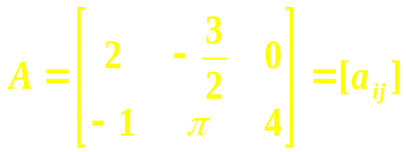

0.2.1 Rectangular arrays
A matrix is an m-by-n array of scalars from a field F. If m = n , the matrix is said to be square . The set of all m-by-n matrices over F is denoted by M_{m, n} (F), and M_{n, n} (F) is often denoted by M_{n} (F) . The vector spaces M_{n, 1} (F) and F^{n} are identical . If F = C , then M_{n} (C) is further abbreviated to M_{n} , and M_{m, n} (C) to M_{m, n} . Matrices are typically denoted by capital letters, and their scalar entries are typically denoted by doubly subscripted lowercase letters . For example , if
then A ∈ M_{2, 3} (R) has entries a₁₁ = 2, a₁₂ = −3/2, a₁₃ = 0, a₂₁ = −1, a₂₂ = π, a₂₃ = 4.
A submatrix of a given matrix is a rectangular array lying in specified subsets of the rows and columns of a given matrix. For example,
is a submatrix (lying in row 2 and column 2 and 3) of A.

Slide 29
0.2 Matrices
0.2.2 Linear transformations
Let U be an n-dimensional vector space and let V be an m-dimensional vector space, both over the same scalar field F ; let B_{U} be a basis of U and let B_{V} be a basis of V.
We may use the isomorphisms x → [x]_{BU} and y → [y]_{BV} to represent vectors in U and V as n-vectors and m-vectors over F, respectively.
A linear transformation is a function T : U → V such that
T ( a₁ x₁ + a₂ x₂ ) = a₁ T ( x₁ ) + a₂ T ( x₂ )
for any scalars a₁ , a₂ and vectors x₁ , x₂ .

Slide 30
0.2 Matrices
0.2.2 Linear transformations
A matrix A ∈ M_{m , n} (F) corresponds to a linear transformation
T : U → V
in the following way:
y = T (x) if and only if [y]_{BV} = A [x]_{BU} .
The matrix A is said to represent the linear transformation T (relative to the bases B_{U} and B_{V} ); The representing matrix A depends on the bases chosen.
When we study a matrix A, we realize that we are studying a linear transformation relative to a particular choice of bases, but explicit appeal to the bases is usually not necessary.

Slide 31
0.2.3 Vector spaces associated with a matrix or linear transformation
Any n-dimensional vector space over F may be identified with F^{n}; we may think of A ∈ M_{m, n} (F) as a linear transformation x → Ax from F^{n} to F^{m}. The domain of this linear transformation is F^{n}; its range is range A = { y ∈ F^{m} : y = Ax for some x ∈ F^{n} }.
The range of A is range A = { y ∈ F^{m} : y = Ax for some x ∈ F^{n} } ;
The null space of A is nullspace A = {x ∈ F^{n}: Ax = 0} ;
The range of A is a subspace of F^{m} ;
The null space of A is a subspace of F^{n} .
The dimension of nullspace A is denoted by nullity A; the dimension of range A is denoted by rank A. These numbers are related by the rank-nullity theorem:
dimension (range A) + dimension (nullspace A) = rank A + nullity A = n .

Slide 32
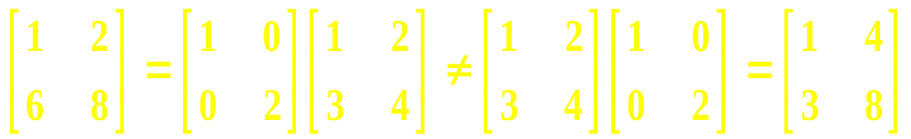
0.2 Matrices
0.2.4 Matrix operations
Matrix addition is defined entrywise for arrays of the same dimensions and is denoted by + ( “A + B” ). It corresponds to addition of linear transformations ( relative to the same basis ) , and it inherits commutativity and associativity from the scalar field. The zero matrix is the additive identity, and M_{m, n} (F) is a vector space over F.
Matrix multiplication is denoted by juxtaposition (“AB”) and corresponds to the composition of linear transformations. Therefore , it is defined only when A∈ M_{m, n} (F) and B ∈ M_{n, q} (F) . It is associative, but not always commutative .
For example,

Slide 33
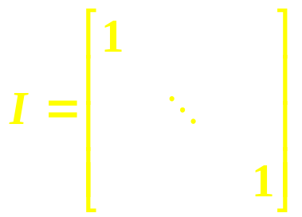
0.2 Matrices
0.2.4 Matrix operations
The identity matrix
∈ M_{n} (F)
is the multiplicative identity in M_{n} (F) .
The identity matrix and all scalar multiples of it ( a scalar matrix ) commute with every matrix in M_{n} (F) ; they are the only matrices that do so.
Matrix multiplication is distributive over matrix addition.

Slide 34
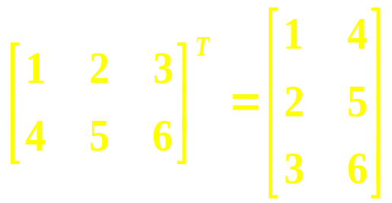
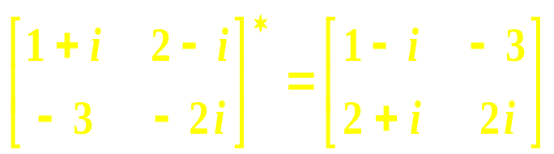
0.2.5 The transpose, conjugate transpose, and trace
If A = [a_{ij}] ∈ M_{m, n} (F), the transpose of A, denoted A^{T}, is that matrix in M_{n, m} (F) whose i , j entry is a_{ji} ; that is, rows are exchanged for columns and vice versa .
For example,
Of course, ( A ^{T} ) ^{T} = A .
The conjugate transpose ( sometimes called the adjoint or Hermitian adjoint ) of A ∈ M _{m, n} (C) , is denoted by A∗ of defined A∗ = A ^{T}, in which A is the entrywise conjugate.
For example,
-
-

Slide 35
0.2 Matrices
0.2.5 The transpose, conjugate transpose, and trace
Both the transpose and the conjugate transpose obey the reverse-order law:
(AB)∗ = B*A*,
(AB)^{T} = B^{T}A^{T},
and
(AB) ^{– 1} = B ^{– 1} A ^{– 1} .
assuming the product is defined.
For the complex conjugate of a product, there is no reversing:
AB = AB .
—
–
–

Slide 36
0.2.6 Metamechanics of matrix multiplication
In addition to the conventional definition of matrix-vector and matrix-matrix multiplication, several alternative viewpoints can be useful.
1. If A ∈ M_{m, n} (F) , x ∈ F^{n} , and y ∈ F^{m}, then the (column) vector Ax is a linear combination of the columns of A; the coefficients of the linear combination are the entries of x . The row vector y^{T}A is a linear combination of the rows of A ; the coefficients of the linear combination are the entries of y .
2. If b_{j} is the jth column of B and a_{i}^{T} is the ith row of A , then the jth column of AB is Ab_{j} and the ith row of AB is just a_{i}^{T}B .
To paraphrase, in the matrix product AB, left multiplication by A multiplies the columns of B and right multiplication by B multiplies the rows of A .

Slide 37
0.2 Matrices
0.2.7 Column space and row space of a matrix
The range of A ∈ M_{m, n} (F) is also called its column space because Ax is a linear combination of the columns of A for any x ∈ F^{n} ( the entries of x are the coefficients in the linear combination); range A is the span of the columns of A . Analogously, { y^{T}A : y ∈ F^{m} } is called the row space of A .

Slide 38
0.2 Matrices
0.2.8 The all-ones matrix and vector
In F^{n} , every entry of the vector e = e₁ + … + e_{n} is 1 . Every entry of the matrix J_{n} = ee^{T} is 1 .

Slide 39
Chapter 0 Review and Miscellanea
0.3 Determinants

Slide 40
0.3 Determinants
0.3.1 Laplace expansion by minors along a row or column
0.3.2 Alternating sums and permutations
0.3.3 Elementary row and column operations
0.3.4 Reduced row echelon form
0.3.5 Multiplicativity
0.3.6 Functional characterization of the determinant

Slide 41
0.3 Determinants
Often in mathematics, it is useful to summarize a multivariate phenomenon with a single number, and the determinant function is an example of this . Its domain is M_{n}(F) (square matrices only), and it may be presented in several different ways. We denote the determinant of A ∈ M_{n} (F) by det A.

Slide 42
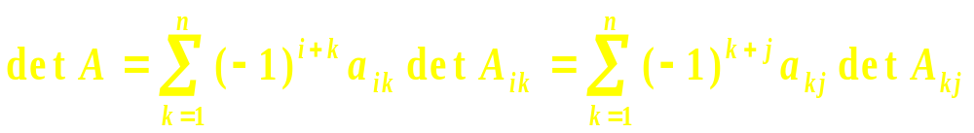
0.3 Determinants
0.3.1 Laplace expansion by minors along a row or column
The determinant may be defined inductively for A = [ a_{ij} ] ∈ M_{n} (F) in the following way . Assume that the determinant is defined over M_{n − 1}(F) and let A_{ij} ∈ M_{n − 1}(F) denote the submatrix of A ∈ M_{n} (F) obtained by deleting row i and column j of A . Then for any i , j ∈ { 1 , … , n }, we have
(0.3.1.1)
The fist sum is the Laplace expansion by minors along row i , and the second sum is the Laplace expansion along column j .

Slide 43

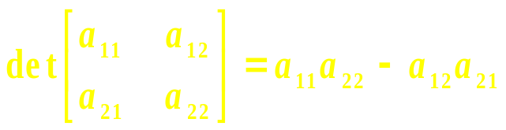
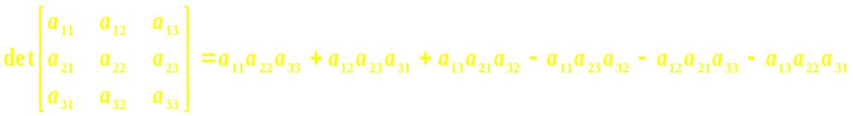
0.3 Determinants
0.3.1 Laplace expansion by minors along a row or column
The inductive presentation begins by defining the determinant of 1-by-1 matrix to be the value of the single entry. Thus,
and so on. Notice that det A^{T} = det A, det A* = det A if A ∈ M_{n}(C), and det I = 1.

Slide 44
0.3 Determinants
0.3.2 Alternating sums and permutations
A permutation of { 1 , … , n } is a one-to-one function
σ : { 1 , … , n } → { 1 , … , n } .
There are n! distinct permutations of { 1 , … , n } .
The identity permutation satisfies σ (i ) = i for each i = 1 , … , n .
The collection of all such permutations forms a group under composition of functions .

Slide 45
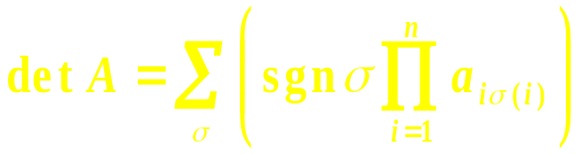
0.3 Determinants
0.3.2 Alternating sums and permutations
Consistent with the low-dimensional examples in (0.3.1) , for A = [ a_{ij} ] ∈ M_{n} (F) we have the alternative presentation
in which the sum is over all n! permutations of { 1 , … , n } and sgn σ , the “sign” or “signum” of a permutation σ , is + 1 or - 1 according to whether the minimum number of transpositions (pairwise interchanges) necessary to achieve it starting from {1, … , n} is even or odd. We say that a permutation σ is even if sgn σ = + 1; σ is odd if sgn σ = − 1 .
(0.3.2.1)

Slide 46
0.3 Determinants
0.3.2 Alternating sums and permutations
If sgn σ in (0.3.2.1) is replaced by certain other functions of σ , one obtains generalized matrix functions in place of det A . For example , the permanent of A , denoted by per A , is obtained by replacing sgn σ by the function that is identically +1 .

Slide 47
0.3 Determinants
0.3.3 Elementary row and column operations
Three simple and fundamental operations on rows or columns, called elementary row and column operations, can be used to transform a matrix ( square or not ) into a simple form that facilitates such tasks as solving linear equations , determining rank , and calculating determinants and inverses of square matrices .
We focus on row operations , which are implemented by matrices that act on the left . Column operations are defined and used in a similar fashion ; the matrices that implement them act on the right .

Slide 48
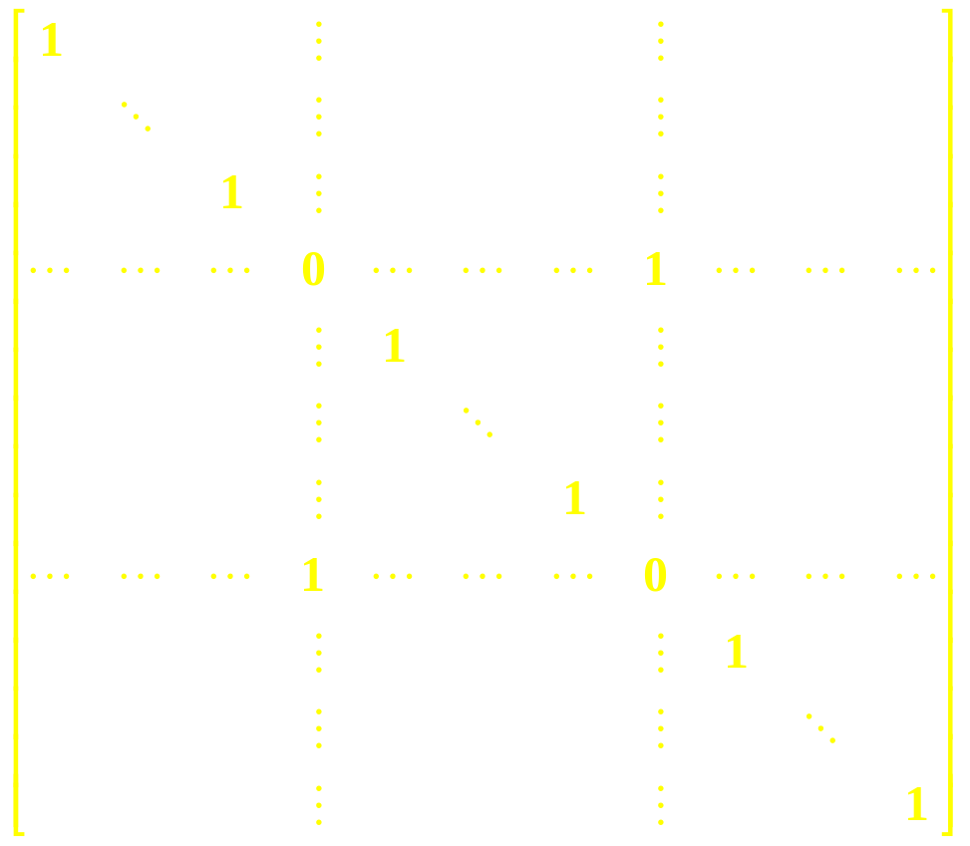
Type 1: Interchange of two rows
For i ≠ j , interchange of rows i and j of A results from left multiplication of A by
row i
row j
column i
column j

Slide 49
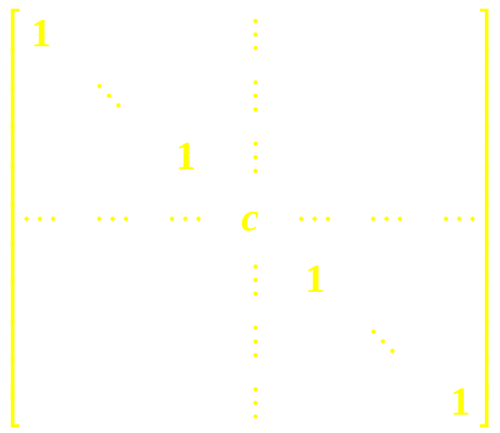
Type 2: Multiplication of a row by a nonzero scalar
Multiplication of row i of A by a nonzero scalar c results from left multiplication of A by
row i
column i

Slide 50
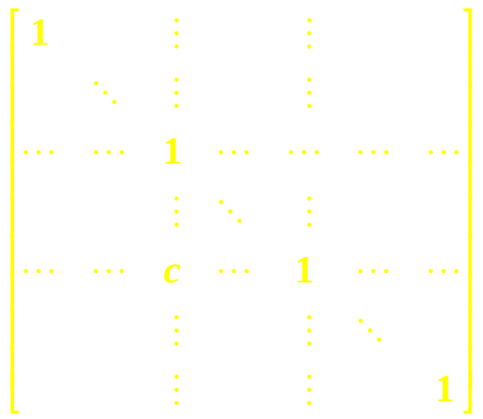
Type 3: Addition of a scalar multiple of one row to another row
For i ≠ j , addition of c times row i of A to row j of A results from left multiplication of A by
column j
row i
row j
column i

Slide 51
0.3.3 Elementary row and column operations
The matrices of each of the three elementary row ( or column ) operations are just the result of applying the respective operation to the identity matrix I ( on the left for a row operation ; on the right for a column operation ) .
The effect of a type 1 operation on the determinant is to multiply it by − 1 ;
The effect of a type 2 operation is to multiply it by the nonzero scalar c ;
A type 3 operation does not change the determinant .
The determinant a square matrix with a zero row is zero .
The determinant of a square matrix is zero if and only if some subset of the rows of the matrix is linearly dependent .

Slide 52
0.3 Determinants
0.3.4 Reduced row echelon form
To each A = [ a_{ij} ]∈ M_{m, n} (F) there corresponds a (unique) canonical form in M_{m, n} (F) , the reduced row echelon form ( RREF ) , also known as the Hermite normal form .
Many matrices have the same RREF, but each matrix has only one RREF regardless of the sequence of elementary operations used to attain it.

Slide 53
0.3 Determinants
0.3.4 Reduced row echelon form
If a row of A is nonzero , its leading entry is its first nonzero entry . The defining specifications of the RREF are as follows:
(a) Any zero rows occur at the bottom of the matrix.
(b) The leading entry of any nonzero row is 1.
(c) All other entries in the column of a leading entry are zero.
(d) The leading entries occur in a stairstep pattern, left to right; that is, if row i
is nonzero and a_{ik} is its leading entry, then either i = m , or row i + 1 is zero,
or the leading entry in row i + 1 is a _{i + 1, l} , in which l > k .

Slide 54
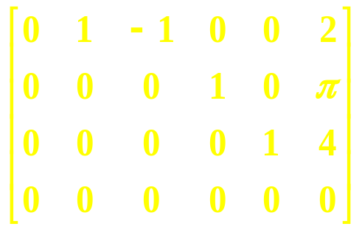
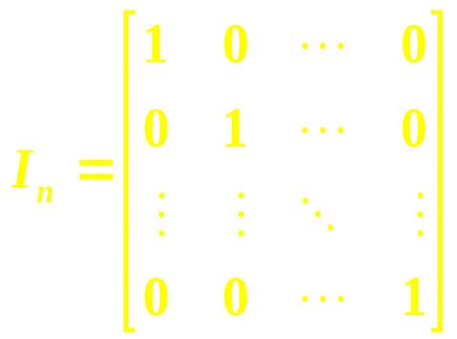
0.3 Determinants
0.3.4 Reduced row echelon form
For example,
is in RREF.
The determinant of A ∈ M_{n}(F) is nonzero if and only if its RREF is the identity
(whose determinant is 1).

Slide 55
0.3 Determinants
0.3.4 Reduced row echelon form
For the system of linear equations Ax = b , with A ∈ M_{m, n} (F) and b ∈ F^{m} given and x ∈ F^{n} unknown, the set of solutions is unchanged if the same sequence of elementary row operations is performed on both A and b. The solutions of Ax = b are revealed by inspection of the RREF of [ A b ] .
Since the RREF is unique, for given A₁ , A₂ ∈ M_{m , n} (F) and given b₁, b₂ ∈ F^{m}, the systems of linear equations A₁x = b₁ and A₂x = b₂ have the same set of solutions if and only if [A₁ b₁] and [A₂ b₂] have the same RREF.

Slide 56
0.3 Determinants
0.3.5 Multiplicativity
A key property of the determinant function is that it is multiplicative:
For A , B ∈ M_{n} (F) ,
det AB = det A det B
This may be proved using elementary operations that row-reduce both A and B .

Slide 57
0.3 Determinants
0.3.6 Functional characterization of the determinant
The determinant function A → det A is the unique function f : M_{n} (F) → F that is
(a) Multilinear in the rows of its argument ;
(b) Alternating : any type 1 operation on A changes the sign of f (A) ;
(c) Normalized : f ( I ) = 1 .

Slide 58
Chapter 0 Review and Miscellanea
0.4 Rank

Slide 59
0.4 Rank
0.4.1 Definition
0.4.2 Rank and linear systems
0.4.3 RREF and rank
0.4.4 Characterizations of rank
0.4.5 Rank inequalities
0.4.6 Rank equalities

Slide 60
0.4 Rank
0.4.1 Definition
If A ∈ M_{m, n} (F) , rank A = dim range A is the length of a longest linearly independent list of columns of A .

Slide 61
0.4 Rank
0.4.1 Definition
There can be more than one linearly independent list of columns whose length equals the rank .
It is a remarkable fact that
rank A^{T} = rank A .
Therefore, an equivalent definition of rank is the length of a longest linearly independent list of rows of A :
row rank = column rank .

Slide 62
0.4 Rank
0.4.2 Rank and linear systems
Let A ∈ M_{m, n} (F) and b ∈ F^{n} be given. The linear system Ax = b may have no solution, exactly one solution, or infinitely many solutions; these are the only possibilities. If there is at least one solution, the linear system is consistent; if there is no solution, the linear system is inconsistent.
The linear system Ax = b is consistent if and only if
rank [A b] = rank A .

Slide 63
0.4.2 Rank and linear systems
The linear system Ax = b is consistent if and only if
rank [A b] = rank A .
The matrix [A b] ∈ M_{m, n+1} (F) is the augmented matrix .
To say that the augmented matrix and the coefficient matrix A of a linear system have the same rank is just to say that b is a linear combination of the columns of A . In this case , appending b to the columns of A does not increase the rank.
A solution of the linear system Ax = b is a vector x whose entries are the coefficients in a representation of b as a linear combination of the columns of A.

Slide 64
0.4 Rank
0.4.3 RREF and rank
Elementary operations do not change the rank of a matrix, and thus rank A is the same as the rank of the RREF of A, which is just the number of nonzero rows in the RREF.

Slide 65
0.4 Rank
0.4.3 RREF and rank
As a practical matter , however , numerical calculation of the rank by calculation of the RREF is unwise . Round-off errors in intermediate numerical calculations can make zero rows of the RREF appear to be nonzero , thereby affecting perception of the rank .

Slide 66
0.4.4 Characterizations of rank
The following statements about a given matrix A ∈ M_{m , n} (F) are equivalent; each can be useful in a different context .
(a) rank A = k .
(b) k, and no more than k, rows of A are linearly independent .
(c) k, and no more than k, columns of A are linearly independent .
(d) some k-by-k submatrix of A has nonzero determinant, and every (k+1)-by-(k+1)
submatrix of A has zero determinant .
(e) dim (range A) = k .
(f) There are k, but no more than k, linearly independent vectors b₁, … , b_{k} such that
the linearly system Ax = b_{j} is consistent for each j = 1 , … , k .
(g) k = n – dim (nullspace A) (the rank-nullity theorem) .
(h) k = min { p : A = XY ^{T} for some X ∈ M_{m, p} (F), Y ∈ M _{n, p} (F) }
(i) k = min { p : A = x₁y₁^{T} + … + x_{p}y_{p}^{T} } for some x₁ , … , x_{p} ∈ F^{m} , y₁ , … , y_{p} ∈ F^{n} .

Slide 67
0.4.5 Rank inequalities
Some fundamental inequalities involving rank are:
(a) If A ∈ M_{m , n} (F) , then rank A ≤ min {m, n} .
(b) If one or more rows and/or columns are deleted from a matrix, the rank of
the resulting submatrix is not greater than the rank of the original matrix.
(c) Sylvester inequality : If A ∈ M_{m, k} (F) and B ∈ M_{k, n} (F) , then
(rank A + rank B) – k ≤ rank AB ≤ min {rank A, rank B}.
(d) The rank-sum inequality : If A, B ∈ M_{m, n} (F) , then
| rank A − rank B | ≤ rank (A + B) ≤ rank A + rank B.
(e) Frobenius inequality : If A ∈ M_{m, k} (F), B ∈ M_{k, p} (F), and C ∈ M_{p, n} (F), then
rank AB + rank BC ≤ rank B + rank ABC.

Slide 68

0.4.6 Rank equalities
Some fundamental equalities involving rank are:
-
(a) If A ∈ M_{m, n} (C) , then rank A∗ = rank A^{T} = rank A = rank A .
(b) If A ∈ M_{m} (F) and C ∈ M_{n} (F) are nonsingular and B ∈ M_{m, n} (F) , then
rank AB = rank B = rank BC = rank ABC ;
that is, left or right multiplication by a nonsingular matrix leaves rank unchanged .
(c) If A, B ∈ M_{m, n} (F) , then rank A = rank B if and only if there exist a nonsingular X
∈ M_{m}(F) and a nonsingular Y ∈ M_{n} (F) such that B = XAY .
(d) If A ∈ M_{m, n} (C) , then rank A∗A = rank A .
(e) Full-rank factorization :
If A ∈ M_{m, n} (F) , then rank A = k if and only if A = XY ^{T} for some X ∈ M_{m, k} (F) and
Y ∈ M_{n, k} (F) that each have independent columns. The equivalent factorization A =
XBY ^{T} for some nonsingular B ∈ M_{k} (F) can also be useful. In particular, rank A = 1
if and only if A = xy^{T} for some nonzero vectors x ∈ F^{m} and y ∈ F^{n} .
(f) If A ∈ M_{m, n} (F) , then rank A = k if and only if there exist nonsingular matrices S ∈
M_{m} (F) and T ∈ M_{n} (F) such that A = S T .

Slide 69
Chapter 0 Review and Miscellanea
0.5 Nonsingularity

Slide 70
0.5 Nonsingularity
A linear transformation or matrix is said to be nonsingular if it produces the output 0 only for the input 0. Otherwise, it is singular.

Slide 71
0.5 Nonsingularity
If A ∈ M _{m, n} (F) and m < n , then A is necessarily singular . ???
An A ∈ M_{n} (F) is invertible if there is a matrix A ⁻¹ ∈ M_{n} (F) (the inverse of A) such that A ⁻¹ A = I .
If A ∈ M_{n} and A ⁻¹ A = I, then AA ⁻¹ = I ; A ⁻¹ is unique whenever it exists .

Slide 72
0.5 Nonsingularity
It is useful to be able to call on a variety of criteria for a square matrix to be nonsingular. The following are equivalent for a given A ∈ M_{n} (F):
(a) A is nonsingular.
(b) A ⁻ ¹ exists.
(c) rank A = n.
(d) The rows of A are linearly independent.
(e) The columns of A are linearly independent.
(f) det A ≠ 0. √
(g) The dimension of the range of A is n.
(h) The dimension of the null space of A is 0.
(i) Ax = b is consistent for each b ∈ F^{n}.
(j) If Ax = b is consistent, then the solution is unique.
(k) Ax = b has a unique solution for each b ∈ F^{n}.
(l) The only solution to Ax = 0 is x = 0.
(m) 0 is not an eigenvalue of A (see Chapter 1).

Slide 73
0.5 Nonsingularity
The nonsingular matrices in M_{n} (F) form a group , the general linear group , often denoted by
GL ( n , F ) .

Slide 74
0.5 Nonsingularity
If A ∈ M_{n} (F) is nonsingular, then
((A ⁻¹)^{T}A^{T} )^{T} = A(A⁻¹) = I ,
so
(A⁻¹)^{T}A^{T} = I ,
which means that
(A⁻¹)^{T} = (A^{T} )⁻¹ .
It is convenient to write either (A⁻¹)^{T} or (A^{T} )⁻¹ as A^{−T} .
If A ∈ M_{n} (C) is nonsingular, then
(A⁻¹)∗ = (A∗)⁻¹ ,
and we may safely write either as A^{− ∗} .

Slide 75
Chapter 0 Review and Miscellanea
0.6 The Euclidean inner product and norm

Slide 76
0.6 The Euclidean inner product and norm
0.6.1 Definitions
0.6.2 Orthogonality and orthonormality
0.6.3 The Cauchy-Schwarz inequality
0.6.4 Gram-Schmidt orthonormalization
0.6.5 Orthonormal bases
0.6.6 Orthonormal complements

Slide 77
0.6 The Euclidean inner product and norm
0.6.1 Definition
The scalar < x , y > = y∗x is the Euclidean inner product ( standard inner product, usual inner product , scalar product , dot product ) of x , y ∈ C^{n} .
The Euclidean norm ( usual norm , Euclidean length ) function on C^{n} is the real-valued function ||x||₂ = < x , x >^{1/2} = ( x∗x )^{1/2} .

Slide 78
0.6 The Euclidean inner product and norm
0.6.2 Orthogonality and orthonormality
Two vectors x , y ∈ C^{n} are called orthogonal if < x , y > = 0 . In R² and R³ , “orthogonal” has the conventional geometric interpretation of perpendicular .
A list of vectors x₁ , … , x_{m} ∈ C^{n} is said to be orthogonal if < x_{i} , x_{j} > = 0 for all distinct i , j ∈ { 1 , … , m } .
An orthogonal list of nonzero vectors is linearly independent .

Slide 79
0.6 The Euclidean inner product and norm
0.6.2 Orthogonality and orthonormality
A vector whose Euclidean norm is 1 is said to be normalized ( a unit vector ) .
For any nonzero x ∈ C^{n} , x / ||x||₂ is a unit vector .
An orthogonal list of vectors is an orthonormal list if each of its elements is a unit vector .

Slide 80
0.6 The Euclidean inner product and norm
0.6.3 The Cauchy-Schwarz inequality
The Cauchy-Schwarz inequality states that
| < x , y > | ≤ || x || ₂ || y || ₂
for all x, y ∈ C^{n} , with equality if and only if one of the vectors is a scalar multiple of the other .

Slide 81
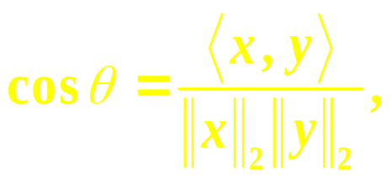

0.6 The Euclidean inner product and norm
0.6.3 The Cauchy-Schwarz inequality
The angle θ between two nonzero real vectors x, y ∈ R^{n} is defined by

Slide 82
0.6 The Euclidean inner product and norm
0.6.4 Gram-Schmidt orthonormalization
Any finite linearly independent list of vectors in an inner product space may be replaced by an orthonormal list with the same span . This replacement may be carried out in many ways , but there is a systematic way to do so that has a useful special property .
The Gram-Schmidt (orthonormalization) process

Slide 83
0.6 The Euclidean inner product and norm
0.6.5 Orthonormal bases
An orthonormal basis of an inner product space is a basis whose elements constitute an orthonormal list .
Since any finite ordered basis may be transformed with the Gram-Schmidt process to an orthonormal basis, any finite-dimensional inner product space has an orthonormal basis , and any orthonormal list may be extended to an orthonormal basis .
Such a basis is pleasant to work with , since the cross terms in inner product calculations all vanish .

Slide 84
0.6.6 Orthogonal complement
Given any subset S ⊂ C^{n} , the orthogonal complement of S is the set
S⊥ ≡ { x ∈ C^{n} : x*y = 0 for all y ∈ S }.
Even if S is not a subspace, S⊥ is always a subspace.
We have (S⊥ )⊥ = Span S , and (S⊥ )⊥ = S if S is a subspace.
It is always the case that
dim S⊥ + dim (S⊥ )⊥ = n .
If S₁ and S₂ are subspaces, then
( S₁ + S₂ )⊥ = S₁⊥ ∩ S₂⊥ .

Slide 85
Chapter 0 Review and Miscellanea
0.7 Partitioned sets and matrices

Slide 86
Chapter 0 Review and Miscellanea
0.8 Determinants again

Slide 87
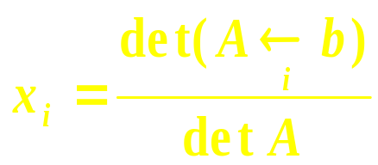
0.8 Determinants again
0.8.3 Cramer’s rule
Cramer’s rule is a useful way to present analytically a particular entry of the solution to Ax = b when A ∈ M_{n} (F) is nonsingular . ???
If det A ≠ 0 , we obtain Cramer’s rule
for the ith entry x_{i} of the solution vector x .

Slide 88
Chapter 0 Review and Miscellanea
0.9 Special types of matrices

Slide 89
0.9 Special types of matrices
0.9.1 Diagonal matrices
0.9.2 Block diagonal matrices and direct sums
0.9.3 Triangular matrices
0.9.4 Block triangular matrices
0.9.5 Permutation matrices
0.9.6 Circulant matrices
0.9.7 Toeplitz matrices
0.9.8 Hankel matrices
0.9.9 Hessenberg matrices
0.9.10 Tridiagonal, bidiagonal, and other structured matrices
0.9.11 Vandermonde matrices and Lagrange interpolation
0.9.12 Cauchy matrices
0.9.13 Involution, nilpotent, projection, coninvolution

Slide 90
0.9 Special types of matrices
Certain matrices of special form arise frequently and have important properties. Some of these are cataloged here for reference and terminology.

Slide 91


Slide 92
0.9 Special types of matrices
0.9.1 Diagonal matrices
A matrix D = [ d _{i j} ] ∈ M_{n , m} (F) is diagonal if d _{i j} = 0 whenever j ≠ i .
For any a₁ , … , a_{n} ∈ F , diag (a₁ , … , a_{n} ) always denotes the matrix A = [ a _{i j} ] ∈ M_{n} (F) such that a_{i i} = a_{i} for each i = 1, … , n and a_{i j} = 0 if i ≠ j .

Slide 93
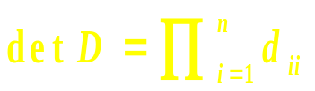
0.9 Special types of matrices
0.9.1 Diagonal matrices
A square diagonal matrix D is a scalar matrix if its diagonal entries are all equal , that is , D = α I for some α ∈ F .
The determinant of a square diagonal matrix D is just the product of its diagonal entries:
Thus, a square diagonal matrix is nonsingular if and only if all its diagonal entries are nonzero.

Slide 94
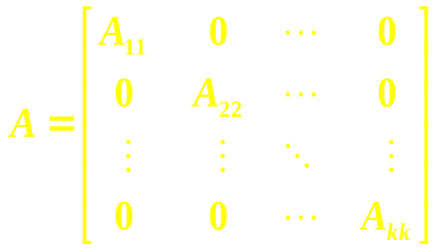
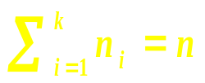
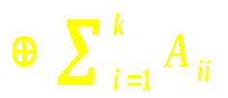
0.9.2 Block diagonal matrices and direct sums
A matrix A ∈ M_{n} (F) of the form
in which A_{ii} ∈ M_{ni} (F) , i = 1, … , k , and , is called block diagonal .
It is convenient to write such a matrix as
A = A₁₁ ⊕ A₂₂ ⊕ …⊕ A_{kk} =
This is the direct sum of the matrices A₁₁ , … , A_{kk} .

Slide 95
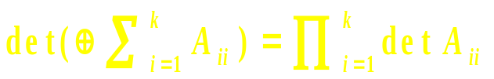
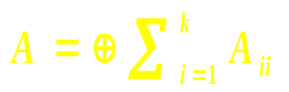
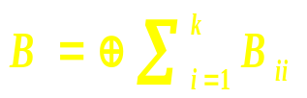
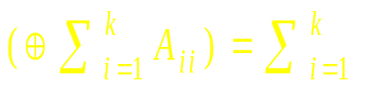
0.9.2 Block diagonal matrices and direct sums
Many properties of block diagonal matrices generalize those of diagonal matrices . For example,
A = ⊕ A_{ii} is nonsingular if and only if each A_{ii} is nonsingular, i = 1, … , k .
Two direct sums and , in which each A_{ii} is the same size as B_{ii} , commute if and only if each pair A_{ii} and B_{ii} commute , i = 1 , … , k .
rank
rank A_{ii} .

Slide 96
0.9 Special types of matrices
0.9.3 Triangular matrices
The matrix T = [ t _{i j} ] ∈ M_{n , m} (F) is upper triangular if t _{i j} = 0 whenever i > j . If t_{i j} = 0 whenever i ≥ j , then T is said to be strictly upper triangular.
Analogously, T is lower triangular (or strictly lower triangular) if its transpose is upper triangular (or strictly upper triangular).

Slide 97
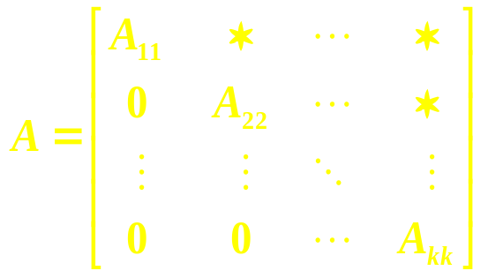
0.9 Special types of matrices
0.9.4 Block triangular matrices
A matrix A ∈ M_{n} (F) of the form
in which A_{ii} ∈ M_{ni} (F) , i = 1, …, k , and , and “ ∗ ” denotes any entry, is block upper triangular. Block lower triangular, strictly block lower triangular, and strictly upper triangular may be defined similarly.

Slide 98
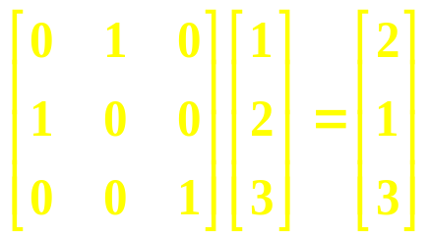
0.9.5 Permutation matrices
A square matrix P is a permutation matrix if exactly one entry in each row and column is equal to 1 and all other entries are 0 . Multiplication by such matrices effects a permutation of the rows or columns of the matrix multiplied.
For example,
illustrates how a permutation matrix produces a permutation of the rows (entries) of a vector : it sends the first entry to the second position, sends the second entry to the first position, and leaves the third entry in the third position.

Slide 99
0.9 Special types of matrices
0.9.5 Permutation matrices
The determinant of a permutation matrix is ± 1 , so permutation matrices are nonsingular . Although permutation matrices need not commute , the product of two permutation matrices is again a permutation matrix .
The identity is a permutation matrix .
P ^{T} = P ⁻ ¹ for every permutation P .

Slide 100
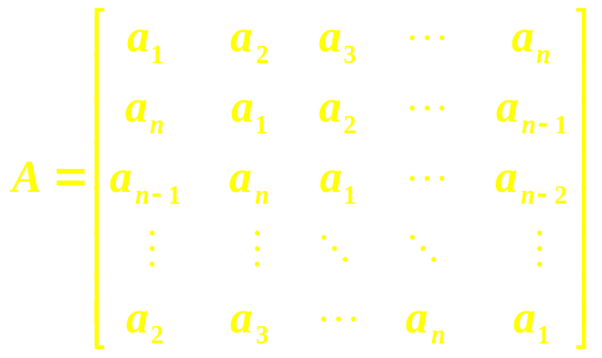
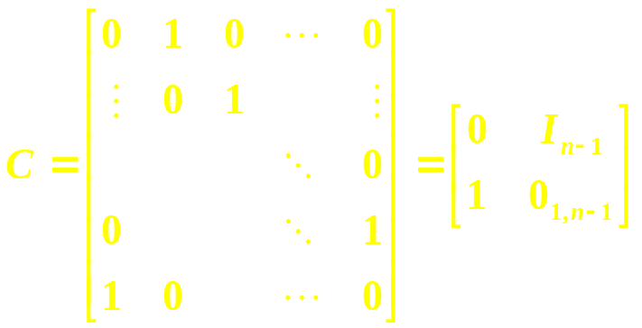
0.9.6 Circulant matrices
A matrix A ∈ M_{n} (F) of the form
is a circulant matrix . Each row is the previous row cycled forward one step ; the entries in each row are a cyclic permutation of those in the first .
The n-by-n permutation matrix
is the basic circulant permutation matrix .

Slide 101
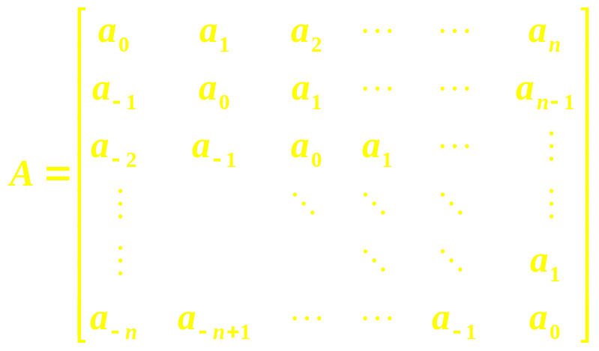
0.9 Special types of matrices
0.9.7 Toeplitz matrices
A matrix A = [ a _{i j} ] ∈ M _{n + 1} (F) of the form
is a Toeplitz matrix . The general term a_{i j} = a_{j - i} for some given sequence
a_{- n} , a_{- n + 1} , … , a₋ ₁ , a₀ , a₁ , a₂ , … , a_{n - 1} , a_{n} ∈ C .
The entries of A are constant down the diagonals parallel to the main diagonal .

Slide 102
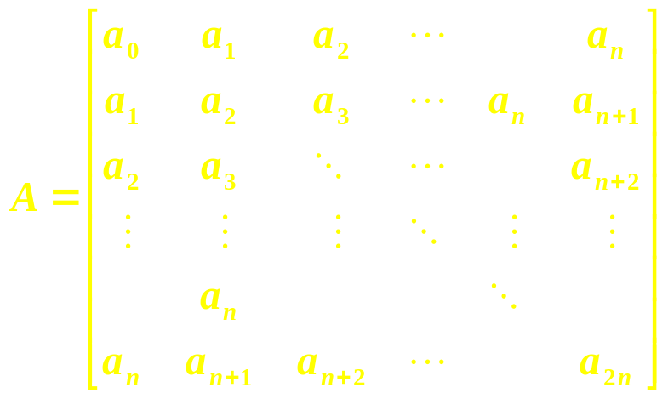
0.9 Special types of matrices
0.9.8 Hankel matrices
A matrix A ∈ M_{n + 1} (F) of the form
is a Hankel matrix . The general term a _{i j} = a _{i + j - 2} for some given sequence
a₀ , a₁ , a₂ , … , a_{2n - 1} , a_{2n} ∈ C .
The entries of A are constant along the diagonals perpendicular to the main diagonal .

Slide 103
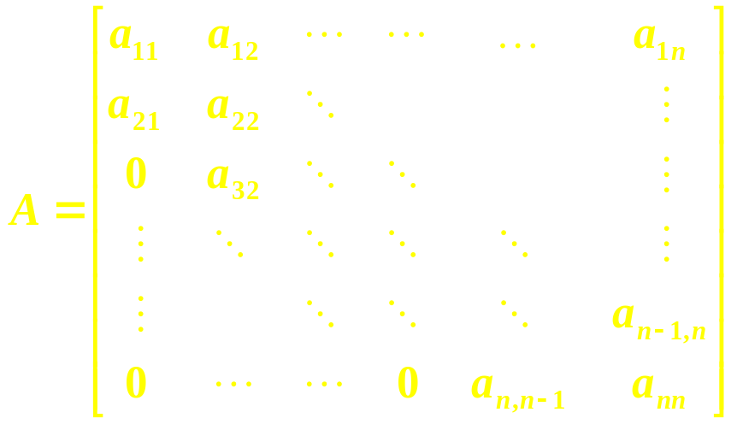
0.9 Special types of matrices
0.9.9 Hessenberg matrices
A matrix A = [ a_{i j} ] ∈ M_{n} (F) is said to be in upper Hessenberg form or to be an upper Hessenberg matrix if a_{i j} = 0 for i > j + 1 :
A matrix A ∈ M_{n} (F) is lower Hessenberg if A^{T} is upper Hessenberg .

Slide 104
Chapter 0 Review and Miscellanea
0.10 Change of Basis

Slide 105

0.10 Change of basis
Let V be an n-dimensional vector space over the field F, and let B₁ = { v₁ , v₂ , … , v_{n} } be a basis for V.
Given the basis B₁ , the linear mapping
x → [ x ] _{B1} ≡
From V to F ^{n} is well defined, one-to-one, and onto. The scalars α _{i} are called the coordinates of x with respect to the basis B₁ , and the column vector [x] _{B1} is the unique B₁ coordinate representation of x.
where x = α₁v₁ + α₂v₂ + … + α_{n}v_{n}

Slide 106

0.10 Change of basis
Let T : V → V be a given linear transformation. The action of T on any x ∈ V is determined once one knows the n vectors T v₁ , T v₂ , … , T v_{n} .
Let B ₂ = { w₁ , w₂ , … , w_{n} } be another, possibly different, basis for V, and suppose that the B ₂ coordinate representation of T v_{j} is
[ T v_{j} ] _{B} ₂ ≡ , j = 1 , 2 , … , n

Slide 107
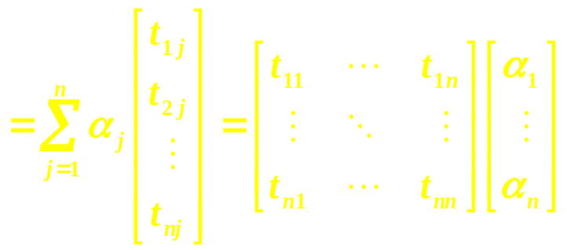

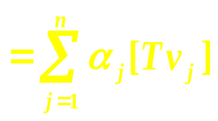
0.10 Change of basis
Then for any x ∈ V we have
The n-by-n array [ t _{i j} ] depends on T and on the choice of the basis B ₁ and B ₂ , but it does not depend on x .
[ T x ] _{B} ₂ =
_{B} ₂
_{B} ₂

Slide 108
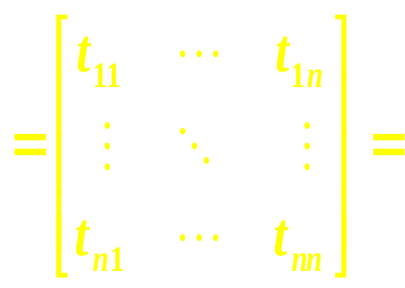
0.10 Change of basis
We define the B ₁ - B ₂ basis representation of T to be
We have just shown that [ T x ] _{B} ₂ = _{B} ₂ [ T ] _{B} ₁ [ x ] _{B} ₁ for any x ∈ V .
In practice, the case B ₂ = B ₁ is the most common one for presenting a basis representation of T ; _{B} ₁ [ T ] _{B} ₁ is called the B ₁ basis representation of T .
_{B} ₂ [ T ] _{B} ₁
[ [ T v ₁ ] _{B} ₂ … [ T v _{n} ] _{B} ₂ ]

Slide 109
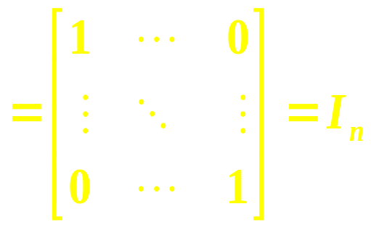
0.10 Change of basis
Consider the identity linear transformation I : V → V defined by Ix = x for all x . Then
[x]_{B} ₂ = [Ix]_{B} ₂ = _{B} ₂[I]_{B} ₁ [x]_{B} ₁ = _{B} ₂[I]_{B} ₁ [Ix]_{B} ₁ = _{B} ₂[I]_{B} ₁ _{B} ₁[I]_{B} ₂ [x]_{B} ₂
for all x ∈ V . By successively choosing x = w ₁ , w ₂ , … , w _{n} , this identity permits us to identify each column of _{B} ₂[I]_{B} ₁ _{B} ₁[I]_{B} ₂ and shows that
_{B} ₂[I]_{B} _{1B} ₁[I]_{B} ₂

Slide 110
Chapter 0 Review and Miscellanea
0.11 Equivalence relations

Slide 111
0.11 Equivalence relations
Let S be a given set and Γ be a given subset of
S × S = {(a , b) : a ∈ S and b ∈ S } .
Then Γ defines a relation on S in the following way : We say that a is related b , written a ∼ b , if (a , b) ∈ Γ .
A relation on S is said to be an equivalence relation if it is
(a) reflexive ( a ∼ a for every a ∈ S ) ;
(b) symmetric ( a ∼ b whenever b ∼ a ) ;
(c) transitive ( a ∼ c whenever a ∼ b and b ∼ c ) .

Slide 112
0.11 Equivalence relations
Whenever an interesting equivalence relation arises in matrix analysis, it can be useful to identify a set of distinguished representatives of the equivalence classes (a canonical form or normal form for the equivalence relation).
Alternatively , we often want to have effective criteria ( invariants ) that can be used to decide if two given matrices belong to the same equivalence class .
For a given equivalence relation in matrix analysis, it is important to make an artful and simple choice of canonical form, and one sometimes does this in more than one way to tailor the canonical form to a specific purpose.

